Slide 1
A Simple Guide to Conducting the Action Research Project
Joshua D. Reichard, PhD, EdS, CCS
President/CEO, Omega Graduate School

Slide 2
What is Action Research?
Action research is a methodological approach that combines action and research to address real-world problems collaboratively and reflectively.
Cyclical Process
Planning, acting, observing, and reflecting, with each cycle aiming to improve and refine the action strategies based on the findings.
Participatory nature, involving stakeholders (such as community members or organizational teams) in the research process to ensure that outcomes are practical and relevant.
Focus on Social Change
Geared towards affecting change and improving practices, policies, or understanding within specific contexts, such as educational settings, organizations, churches, or communities.
Integrates theoretical knowledge with practical application, ensuring that the research directly informs and is informed by action.

Slide 3
Some Important Distinctions
Action Research IS | Action Research is NOT
A simplified report on your attempt to lead change | A dissertation or formal academic research study
Relevant to your immediate professional needs | Abstract and theoretical
Anecdotal and reflective (no direct interaction with participants) | Based on complex hypothesis testing (chi-squared analysis is acceptable)

Slide 4
A Simplified Action Research Process
Problem
Identify something that needs to change
Intervention
Take some action to change it
Reflection
Evaluate whether the change was successful

Slide 5
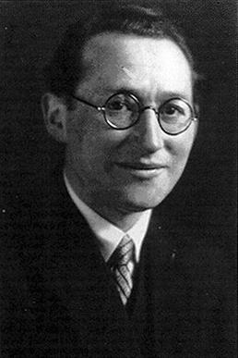
Kurt Lewin
Lewin is often credited as the founder of action research in the 1940s.
His work emphasized the importance of a participatory and iterative process of planning, action, and fact-finding.
Key Contributions
Developed the model of action research consisting of the cycles of planning, action, and observation.
His approach was grounded in solving real-world social problems and was collaborative in nature.

Slide 6
John Heron and Peter Reason
In the 1980s, Heron and Reason expanded on Lewin’s ideas and developed the concept of cooperative inquiry.
Key Contributions
Emphasized research “with” rather than “on” people.
Focused on the involvement of researchers and participants as co-inquirers and co-participants in the research process.

Slide 7
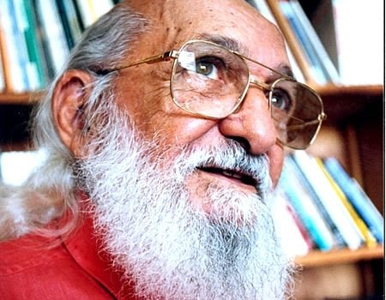
Paulo Freire
Although not solely focused on action research, Freire's ideas in the mid-20th century greatly influenced the field.
Key Contributions
Advocated for a participatory approach in education and social change, emphasizing dialogue and critical consciousness.
His approach to pedagogy has been influential in developing participatory action research methods that seek to empower marginalized groups.

Slide 8
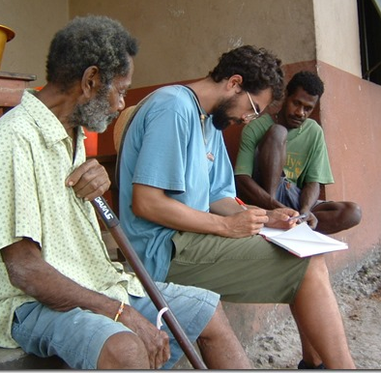
Ethnography
Ethnography in action research focuses on understanding social problems within their natural context.
Detailed observation and anecdotal gathering of data within communities or organizations.
Ethnographic observations are subjective and anecdotal by nature.
Site permission will likely be required.
NOTE: You are observing the group not collecting data from individuals!

Slide 9
Sociological Intervention Concept
Problem Identification/Diagnosis
Intervention Design
Delivery
Evaluation

Slide 10
A Simple Example
Problem: Recent church committee has ended with conflict over a capital campaign
Data (Pre-Intervention): Committee members have verbally expressed frustration over how the meetings are going; with permission, observe the meeting and describe (without identifying participants) collective behaviors, interactions, and emotions.
Intervention: Conduct a workshop on effective communication strategies
Evaluation (Post-Intervention): Observe and describe behavior again.
Reflection: Did it work? To what extent has the problem been addressed?

Slide 11
Identifying a Problem
Background and Significance
What is a problem in your church, community, or organizational context?
What is the background of this problem?
Why is this problem important? Why do you care about it?
What does the broader existing literature say about this problem?
How does the literature apply to your professional context?

Slide 12
Composing a Problem Statement
The problem is members of a church committee are experiencing a stalemate in decision-making due to interpersonal conflicts.
WHO is experiencing the problem?
WHAT is the problem?
WHY might it be happening?

Slide 13
Composing an Action Research Question
How can a training workshop in effective communication strategies reduce interpersonal conflicts to improve decision-making for members of a church committee?
WHAT is the nature of the intervention?
HOW will the problem be mitigated?
WHO is will the intervention benefit?
WHAT is the expected outcome?

Slide 14
Data Collection in Action Research
No direct interaction with human participants!
No surveys, questionnaires, interviews, or focus groups!
Anecdotal descriptions of group behavior without naming individuals
Frequency counts
Attendance numbers
Observations
Publicly available data

Slide 15
Taking Action: Intervention
Action Plan
What research-based change, program, or intervention can address the problem?
Where will my action take place?
How can I get permission to implement the intervention?
How will I ensure I do not have direct contact with participants?
How will I know if the intervention makes a difference?

Slide 16
A Research-Based Intervention
Interventions Should Be
Ethical
Grounded in scholarly literature (a validated program or practice)
Supported by a sociological theory and relevant to applied or clinical sociological practice
Integrated with a relevant faith perspective
Reflective of a relevant leadership theory

Slide 17
Deeper Evaluation: Chi-Squared Analysis
Chi-squared tests can assess the association between categorical variables (observed frequencies) in action research.
Useful in scenarios where direct interaction with participants is either impractical or unnecessary, as it relies solely on existing or broadly observable data.
Chi-squared analyses do not use surveys, ratings scales, etc.

Slide 18
Chi-Squared Research Design
Identify two frequency counts of categorical variables related to the problem and intervention:
For example, attendance or participation counts before/after some intervention (such as a training workshop)
Identify at least two categories to test for association with the frequency counts:
For example, active versus inactive status of volunteers.
Test the hypothesis for association between the categorical variables.

Slide 19
Chi-Squared Matrices
 | Before Training Workshop | After Training Workshop
Number of Active Volunteers | 17 | 22
Number of Inactive Volunteers | 8 | 3

Slide 20
Chi-Squared Research Questions and Hypotheses
RQ: What association exists between active and inactive volunteer counts before and after a training workshop to inform volunteers on the need for active participation?
H0 (Null Hypothesis): No statistically significant association exists between active and inactive volunteer counts before and after a training workshop to inform volunteers on the need for active participation.
Ha (Alternate Hypothesis): A statistically significant association exists between active and inactive volunteer counts before and after a training workshop to inform volunteers on the need for active participation.

Slide 21
Interpreting the Chi-Squared p-Value
Chi-Squared analysis will return a “p-value” (probability value) that the null hypothesis can be reliably rejected.
It is usually tested against a 95% probability, meaning, if we repeated the intervention 100 times, 95 times the results would be (statistically) the same.
If the p-value is less than .05, then the null hypothesis can be rejected.

Slide 22
Taking Action: Reflection
Evaluation
Did things go according to plan? What happened unexpectedly?
Did the intervention address the problem? How do I know?
What could I have done differently?
How did this experience affect me professionally? What did I learn about leadership in the process?
How can this project advance constructive social change?
Future Research
How could a similar action be improved in the future?

Slide 23
Final Tips
Do not overcomplicate it! Keep It Simple Scholar!
Focus on the quality of the intervention.
Ensure ethical procedures!

