Slide 1
Action Research Project SR 920-DSL Proposal
Russ Bergeman
Rev. 5/28/24

Slide 2
Introduction
Objectives and scope
Objective – Create stronger men by introducing the MMFC ministry to Catholic men in the Bradenton, FL area.
Introduce/Invite 600 men to a MMFC Phase 1 weekend.
Produce 20 new “missioners” to attend a Phase 1 MMFC weekend.
Scope:
Catholic Men
6 Parishes near Bradenton, FL
Inviting men to 4+ upcoming MMFC weekend events
Sociological Theory
Social Capital – The formal and/or informal norms and mores that create trust and cohesion within a social group.
Social Capital has been significantly studied and viewed as a way to measure the “success” of social groups.
Social Capital has a significant role for religion as a source and an outcome in group dynamics.
Why Social Capital?
MMFC creates Social Capital through its relational processes. Social Capital is an outcome of the MMFC ministry.
Social Capital can be used a lens to view the imbalance of faith practices in leadership in MMFC.
Based on relationships, trust, cohesion, etc.
Using the principles of Social Capital will assist in the intervention process.
Bring social capital to the intervention process.

Slide 3
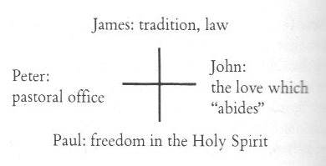
Introduction (Continued)
Sociological Theory
Theological work of Hans Urs Von Balthasar
Based on the idea that the Church is embodied in the world, and every community and every individual Christian life takes shape amid the tension and dynamism that exists between these poles.
An exploration of the tension between the hierarchical structure of the Church and the radical equality of all believers in Christ.
Why Christological Constellation?
Christ-centered theory that recognizes the differences of believers and the gifts they bring to society.
Celebrates the “tension” between gifts (personalities, values, beliefs, etc.) that are present in communities of believers.
MMFC is interdenominational and therefore is inherently imbued with “tensions” that can be identified and celebrated as necessary for success.

Slide 4
Statement of the Problem
The problem addressed in this project is that Marked Men For Christ (MMFC) in Florida is underrepresented by Roman Catholic participation.
MMFC
MMFC is an interdenominational ministry that invites participation from all Christian denominations and faith practices.
MMFC is designed to be exclusively Christian, but inclusive of all Christian faith practices.
The problem addressed in this project is founded in a symbiotic relationship. In other words, MMFC needs Catholics and Catholics need MMFC.

Slide 5
Background of the Problem
Problem Overview
Florida’s MMFC expansion is the largest in the ministry’s reach.
The problem identified is that this ministry’s Florida arm is growing with men participating who are disproportionately non-Catholic
Historical Context
MMFC is led by the Holy Spirit. The Holy Spirit tends to work through word-of-mouth information passing.
The cause of the disproportionate growth of non-Catholic men is, at least partially, because the leadership team in Florida is primarily of a Protestant/Non-Catholic faith practice.
The base team that “planted” MMFC in Florida were non-Catholics. It would stand to reason that the word-of-mouth process would be predominately focused on the men met where they worship.

Slide 6
Purpose
The purpose of this action research project is to address and influence the problem of the underrepresentation of Catholic men participating in the MMFC experience.
Increase Social Capital among the Bradenton, FL Christian community.
Recognize the gifts of a diverse set of Christians and how they can come together to discover the healing that can only occur by the power of Jesus Christ.

Slide 7
Significance
The problem is significant for two reasons:
There is an underrepresentation of Catholic men in the participation (missioners and staff/leadership) in the Florida chapter of MMFC.
The imbalance negatively impacts ecumenical opportunities.
Ignores the gifts that Catholic men, as they practice their faith, bring to the ministry.
Catholic men and the Catholic community will benefit from experiencing the ministry
Catholic men need healing as much as non-Catholic men.
Men who participate in MMFC become better husbands, fathers, leaders, etc in their communities.

Slide 8
Research Question
Can participation in MMFC of Catholic men be increased through appropriate intervention?
How can this intervention be viewed through the:
Sociological lens of Social Capital, and
Theological lens of the Christological Constellation?

Slide 9
Action Plan
The research-based intervention utilized to address the problem in the action research is to introduce/invite men from several local Catholic parishes to experience MMFC.
The location of the initial intervention will be:
Wherever Catholic men can be found, but especially at their home parishes.
The duration of the intervention will be 1 – 2 months.
Upcoming Phase 1 Experiences in Florida:
October 18, 2024 – Camp Kulaqua
November 8, 2024 – Camp Valor
December 6, 2024 – Church of the Nazarene
February 7, 2025 – Christian Retreat Conference Center, Bradenton*

Slide 10
Ethical Considerations
Adherence to Professional Ethics
Professional ethics will be followed and strictly adhered to.
Respect for Persons
A key element of the MMFC process is to provide a non-judgmental and loving environment for men to be truly authentic.
Confidentiality and Privacy
Privacy and confidentiality are not only important to ensure the academic rigor of this project, but it is also an imperative with respect to any association with MMFC.
Avoiding Harm
Any sense or indication that the intervention is causing more harm to a man, or a group will cause the intervention to be paused.
Cultural Sensitivity
Non anticipated
Addressing and Disclosing Bias
Practicing Catholic
Active member of MMFC
Transparency and Accountability
A field journal will be maintained throughout the intervention and post-intervention analysis.
A simple spreadsheet will track engagements, invitations, and acceptances. No names or any other demographic data will be collected.
Site Permissions
Each parish will require different levels of permission to address members of the faith community.
This research will comply with specific permission requirements of the individual parishes.
Researching will actively participate in the MMFC Phase 1 weekends to which men are invited.

Slide 11
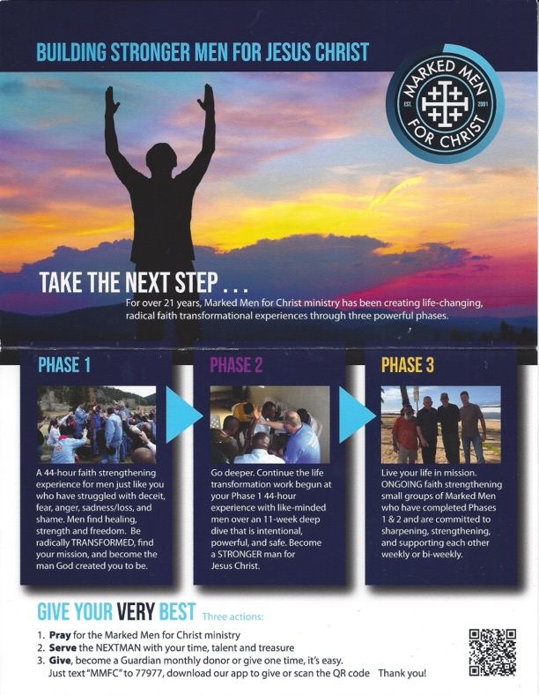
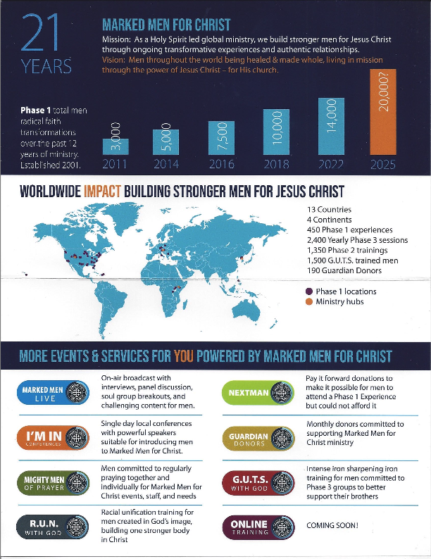
Intervention

Slide 12
Data Collection and Analysis
Data will be collected for a period of 1-2 months (coinciding with the intervention).
Approximately 200 Catholics are expected to be encountered.
Results of pre and post intervention will be evaluated for patterns and themes by keeping a detailed Field Journal and a primitive count of encounters (introduction to MMFC and/or invitation to an MMFC weekend event).
The Chi-Squared Data Analysis tool will be used in addition to the Field Journal for the final analysis of the action related results.

Slide 13
Final Comments
I anticipate several outcomes of this project:
Increased participation of Catholic men in MMFC
Identification of the link between Social Capital and Von Balthasar’s framework.
Researcher observation of “tensions” that may exist with different personalities (archetypes) as men are introduced to MMFC
Observation of the potential impact of increased social capital in small communities as men of different parishes participate in MMFC
Observation of the impact of social capital within the FL MMFC group with the addition of Catholic men
Researcher learning about himself as he participates in a relatively formalized evangelization effort. This is a new endeavor for the researcher so there is going to be a learning curve that will be documented in the journal.

